Slide 1
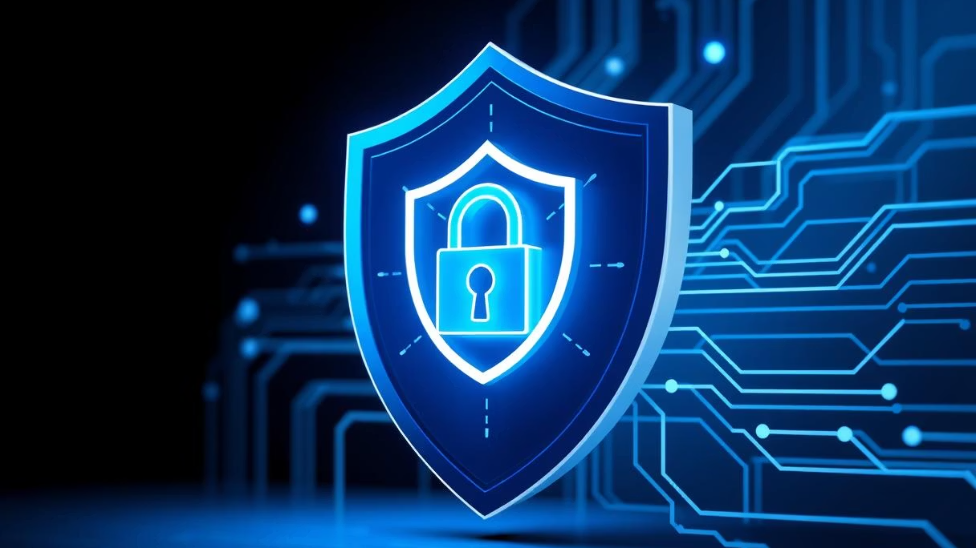
Phishing Awareness Training
Your First Line of Defense
Cybersecurity Training Module
2024
Essential Skills for Digital Safety
Security Awareness

Slide 2


The Threat Landscape
Why Phishing Matters
90%
$4.65M
85%
Of cyberattacks start with phishing
Average cost of a data breach
Breaches involve human element
IBM Cost of Data Breach Report 2023
Verizon Data Breach Investigations Report 2023
People are both the target and the solution
Our Goal: Equip you with the knowledge and skills to identify, avoid, and report phishing attempts effectively.

Slide 3

Recognition & Detection

Slide 4
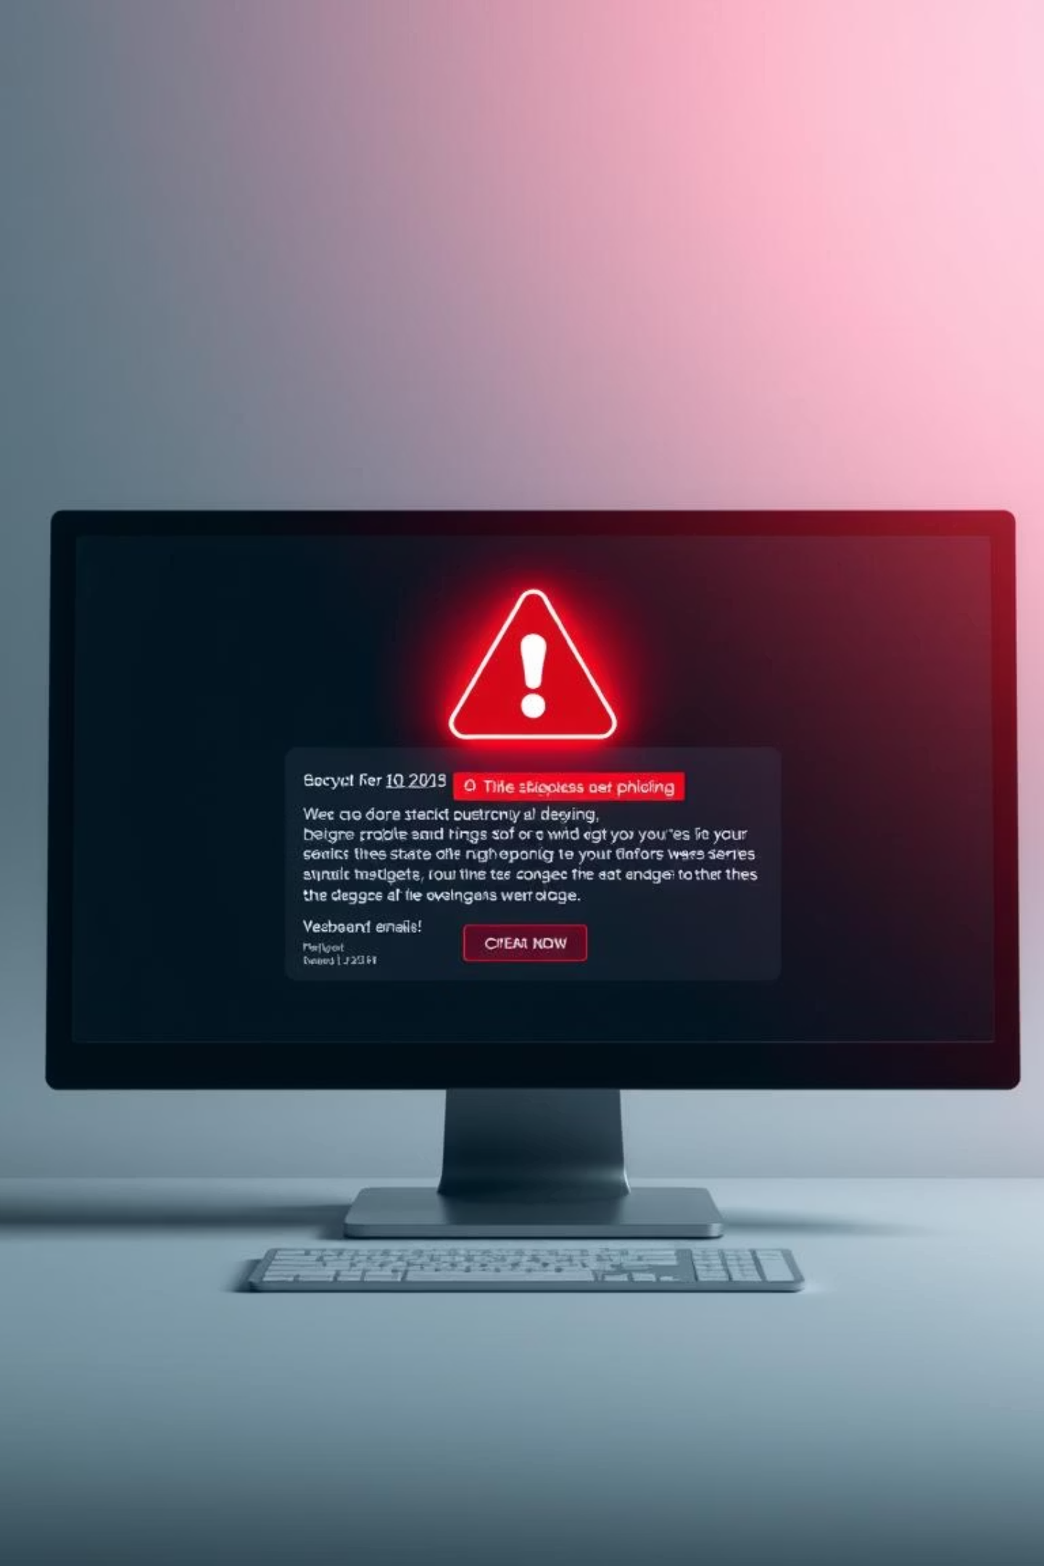





Phishing Email Red Flags
Suspicious Sender
Urgent Language
Email addresses don't match displayed names (e.g., support@micorsoft.com)
Demands immediate action, threatens account closure ("Act now!")
Generic Greetings
Poor Grammar
"Dear Customer" instead of your actual name
Numerous errors, unprofessional tone and formatting
Suspicious Links
Hover to reveal URLs that don't match the sender's domain

Slide 5
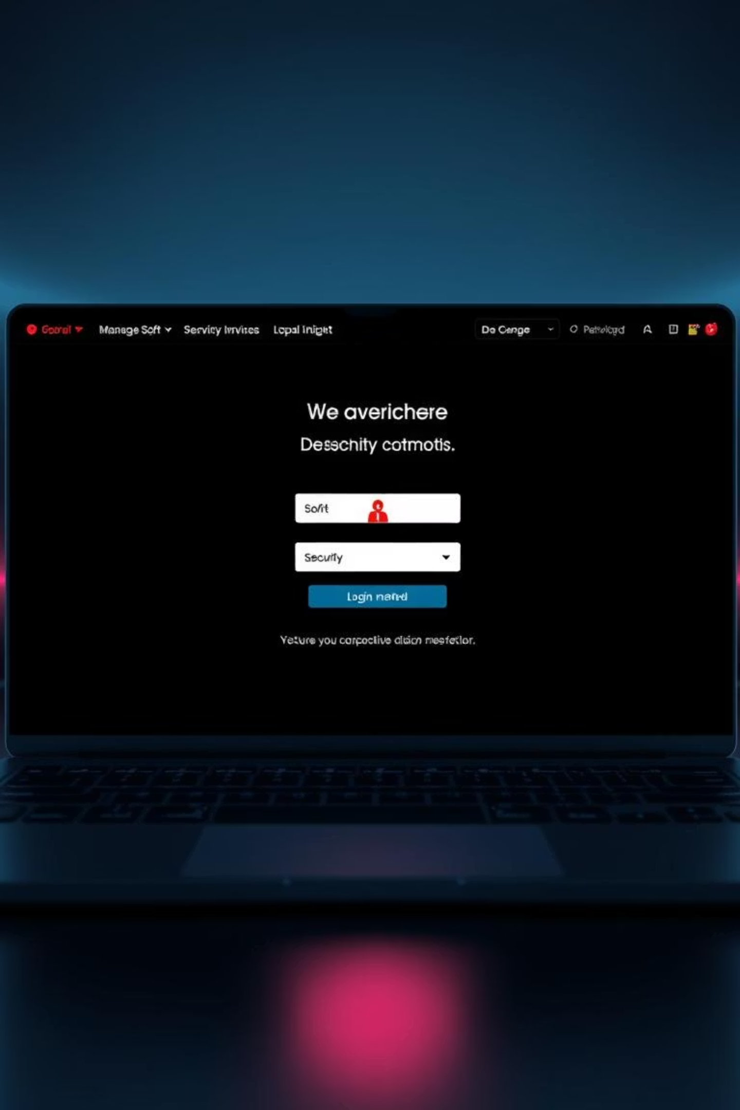

Fake Websites & Social Engineering
Fake Website Signs
Social Engineering Tactics
URL Mismatches: Misspellings, extra words (amazzon.com)
Pretexting: Creates believable fabricated scenarios
No HTTPS/Padlock: Missing secure connection
Authority Impersonation: Pretends to be CEO, IT, law enforcement
Poor Design: Low-resolution logos, inconsistent branding
Urgency/Fear: Creates panic, pressures quick decisions
Excessive Requests: Asks for unusual personal data
Quid Pro Quo: Promises benefit for information

Slide 6

Protection Strategies

Slide 7






Best Practices: Your Defense Toolkit
Verify Senders
Hover Before Clicking
Multi-Factor Authentication
Always double-check email addresses and source legitimacy before responding
Check the true destination URL before clicking any links
Adds critical second layer, blocks 99.9% of automated attacks
Report Suspicious Activity
Strong, Unique Passwords
Keep Software Updated
Forward suspicious emails to IT/security team immediately
Use a password manager, avoid password reuse across accounts
Patch vulnerabilities regularly on all devices and applications

Slide 8

Real-World Examples

Slide 9


Common Phishing Scenarios
Invoice Fraud
HR Payroll Update
IT Support Scam
Fake invoice for $15,000 sent from "vendor," requesting payment to new bank account details
Email with link to "update payroll info," actually stealing employee credentials and personal data
Pop-up or email claiming "technical issue," asking for remote access or login details
CEO Impersonation (BEC)
Email from "CEO" demanding urgent wire transfer to new account—cost businesses $2.7 billion in 2022

Slide 10

Knowledge Check

Slide 11

Interactive Quiz
1
Identify 3 red flags in the provided sample phishing email
Review the email example and spot the warning signs we've discussed
2
What is the safest action if you receive a suspicious email?
Think about the proper response protocol for potential threats
3
How does Multi-Factor Authentication (MFA) protect you?
Explain the security benefits and why it's so effective

Slide 12
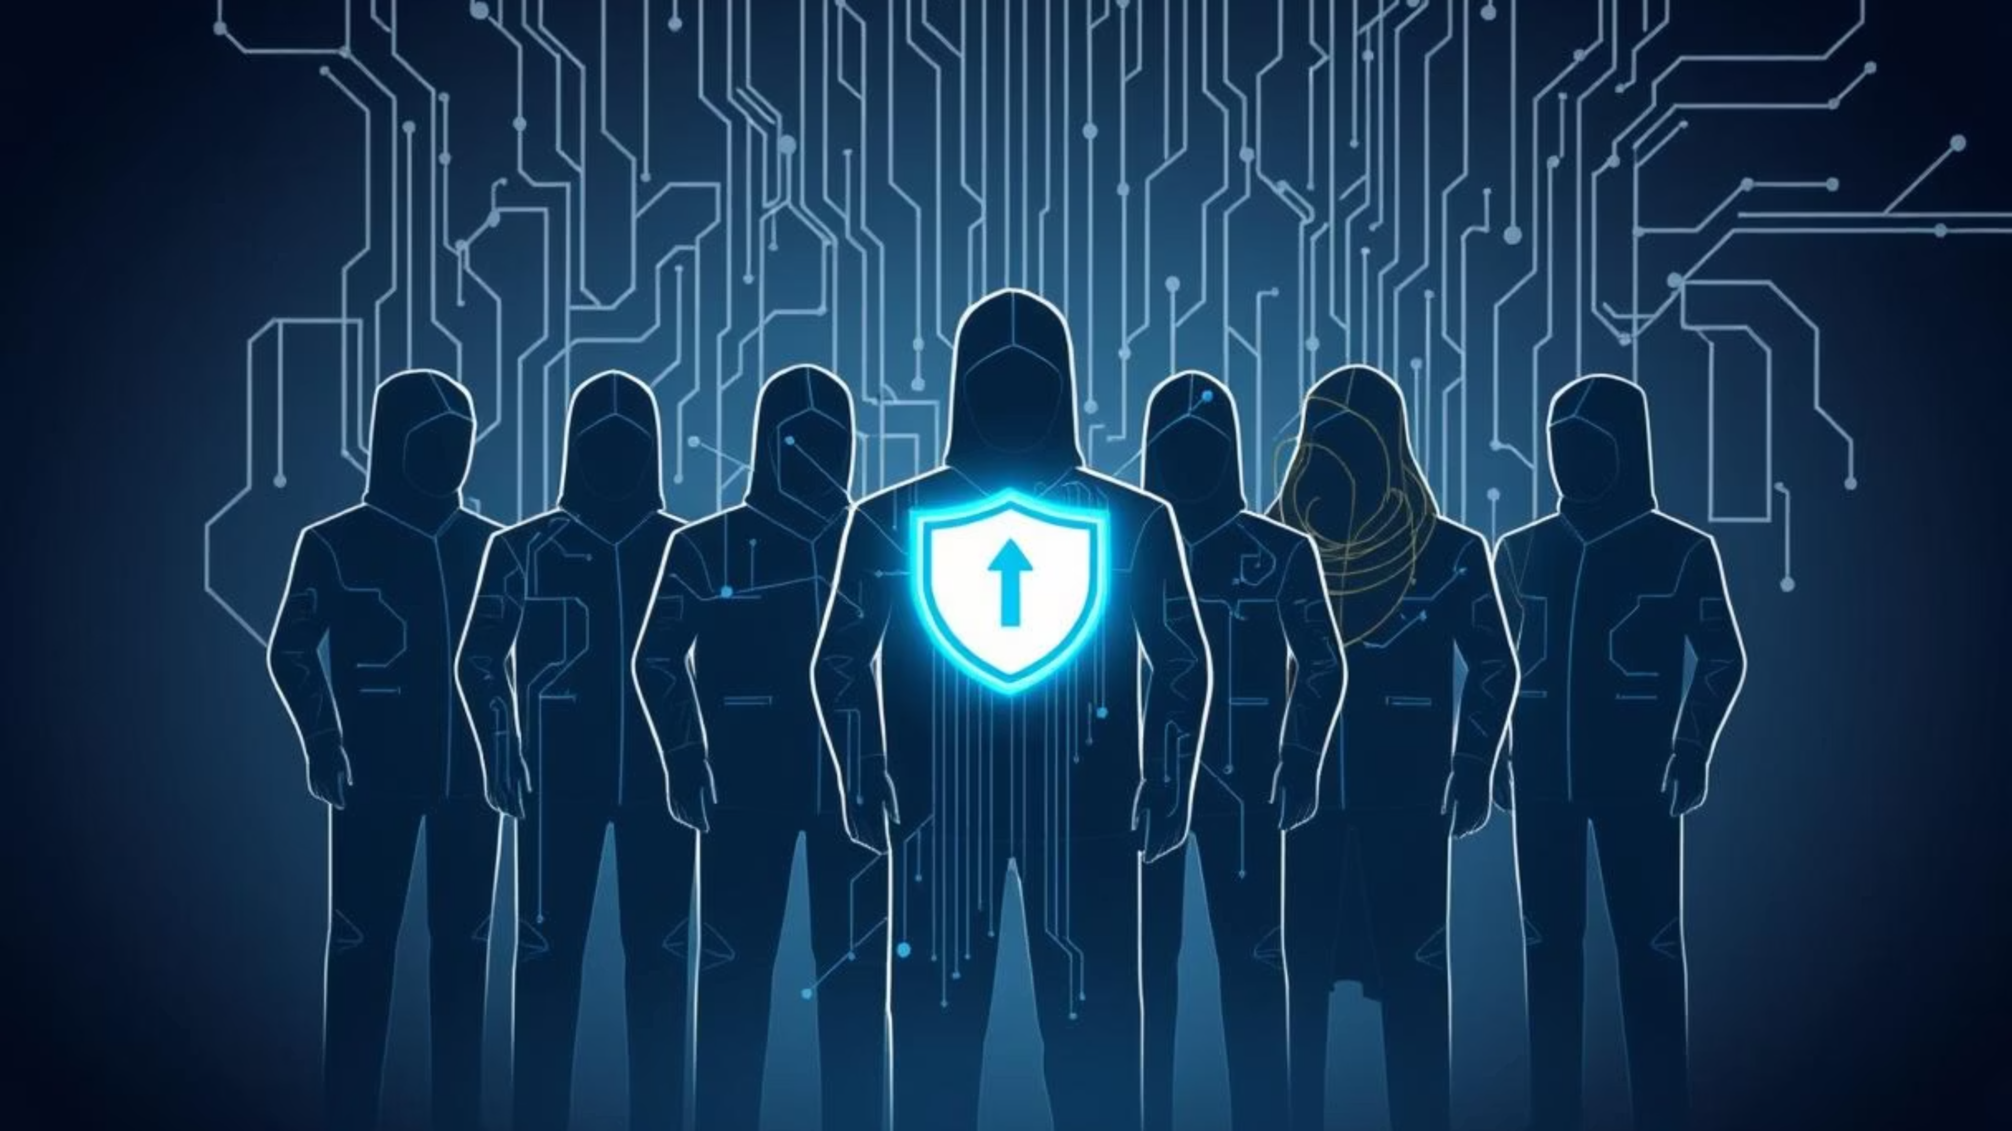
You Are Our Defense
Be vigilant, verify, and report
Remember: 85% of all breaches involve a human element (Verizon DBIR 2023)
You are a critical part of our cybersecurity defense. Your awareness and actions make the difference between a blocked attack and a successful breach.

